Slide 1
Documentum Artifacts on Composer
Notes:
Place the audio notes for this slide here

Slide 2

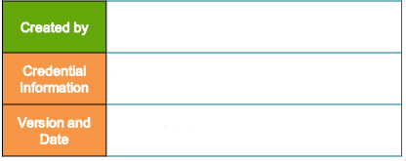
Ravindranath Karuturi (299786)
Documentum Composer V 7.3
V 0.2, 15th March 2018

Slide 3
Agenda
Documentum Composer Overview
Installing and Configuring Composer
Managing Composer Projects
Composer vs Headless Composer
Managing Aspects and Object Types
Managing Documentum Methods
Managing Documentum Jobs

Slide 4
Agenda
Managing Documentum Lifecycles
Managing Modules
Managing Aspect’s
Managing Permission Sets (ACLs)
Managing Roles and Groups
Building and Installing a Composer Project
Dar Deployment using Dar Installer

Slide 5
Documentum Composer Overview

Slide 6
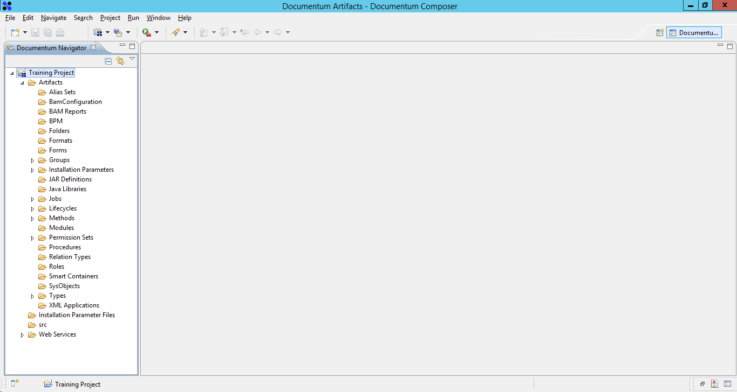
Documentum Composer Overview
Composer is an eclipse based Documentum stand-alone platform.
Composer is used to create, customize, Deploy Artifacts.
Note: Documentum Composer version should always be same as the repository, where artifacts are needed to be installed.

Slide 7
Test Your Understanding
Select the Suitable option for Composer
Is it a new Technology\Programming Platform
Is it a Documentum custom Utility
Stand alone platform on top of Eclipse
Ans: c

Slide 8
Test Your Understanding
Can Composer be used to Package and Deploy Artifacts?
Yes
No
Ans: a

Slide 9
Installing and Configuring Composer

Slide 10
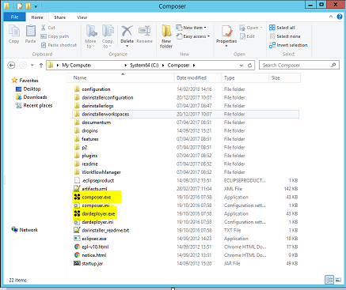
Installing and Configuring Composer
Pre-requisites prior to Installing Composer.
1. Java 6.x or above JDK should be available on the Machine.
2. Documentum 6.x or above repositories to be available.
Installation of Composer
1. Extract the contents of the zip file. This creates composer directory with “Composer.exe”

Slide 11
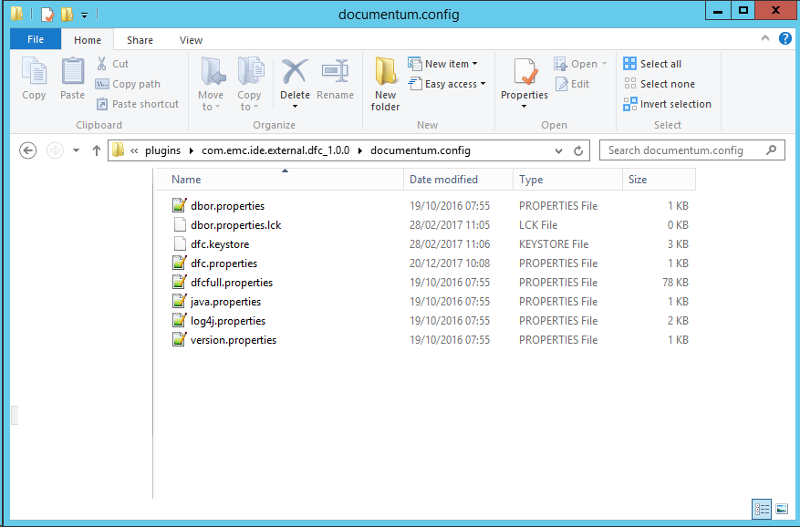
Installing and Configuring Composer
Installation of Composer
1. Set the JAVA_HOME environmental variable
2. Point dfc.properties in the below location towards your repository.
<composer_root>\plugins\com.emc.ide.external.dfc_1.0.0\documentum.config\dfc.properties

Slide 12
Test Your Understanding
How do we setup Composer?
By Selecting .exe file and installing
Running an batch program for deployment
Unzip, Configure and use the composer.
Ans: c

Slide 13
Managing Composer Projects

Slide 14
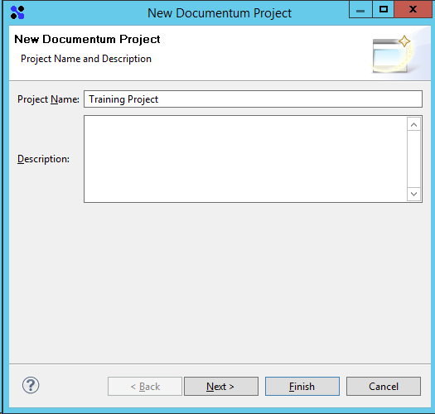
Managing Composer Projects
Creating new Composer Project
> File -> New -> Documentum Project

Slide 15
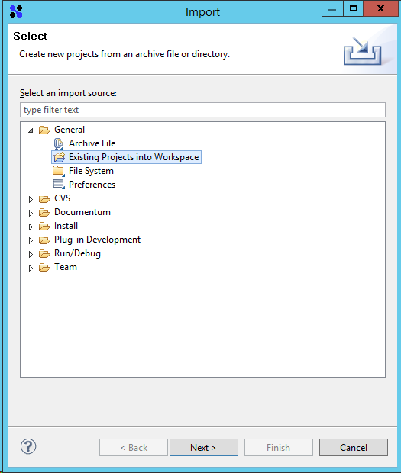
Managing Composer Projects
Import an existing project into Composer
Import > General > Existing Projects into Workspace

Slide 16
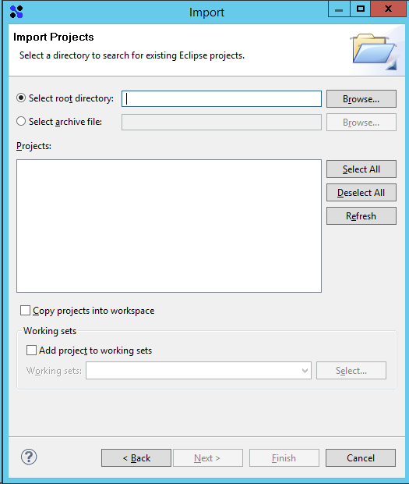
Managing Composer Projects
II. Select the existing Composer project path.
Note: Don’t use this if source control is enabled on the artifacts.

Slide 17
Test Your Understanding
Can Composer Import Existing Project’s or Deployed Artifacts from Documentum environment?
Yes
No
Ans: a

Slide 18
Test Your Understanding
Can Composer Convert an Java Project files to Documentum Project artifacts?
Yes
No
Ans: b

Slide 19
Composer
vs Headless Composer

Slide 20
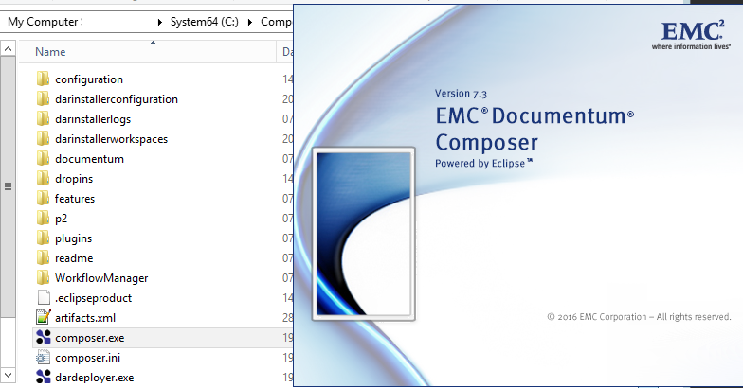
Composer vs Headless Composer
Composer is the fully integrated development environment (IDE) to create, build and install Composer Projects.
Headless Composer is a Command line Deployment tool to Deploy Dar’s or create, build and Install with ANT targets.

Slide 21
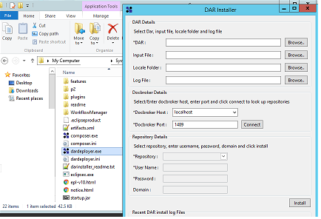
Composer vs Headless Composer
Dar Installer UI is provided by the Composer for Artifacts Deployment into various environments.

Slide 22
Test Your Understanding
Is there any other option provided by composer for Dar Deployment?
Dar can be deployed only via Composer
Dar can be deployed by double clicking the dar file.
Dar can be deployed by double clicking the exe file.
DAR installer can also be used for deployment
Ans: d

Slide 23
Managing Aspects and Object Types

Slide 24
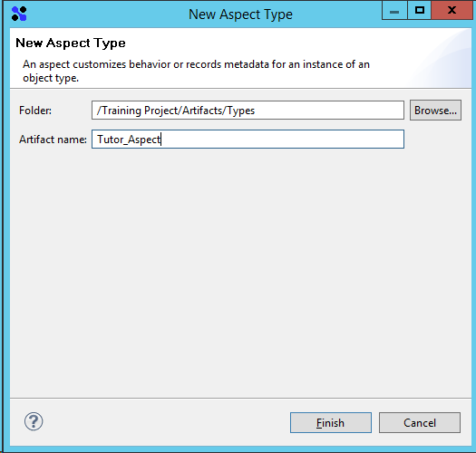
Managing Aspects and Object Types
Aspects are the new members of the Business Objects Framework (BOF) from Documentum 6 which behave like Type Based Objects(TBO) except that they can be mapped to any object type dynamically during runtime.
In another words, aspects are associated with the objects instead of to the object type. Aspects store in the Documentum under dmc_aspect_type object type.
An aspect module consists of executable business logic and supporting material for an aspect, such as third-party software and documentation.
Creating an Aspect Type
File New -> Aspect Type

Slide 25
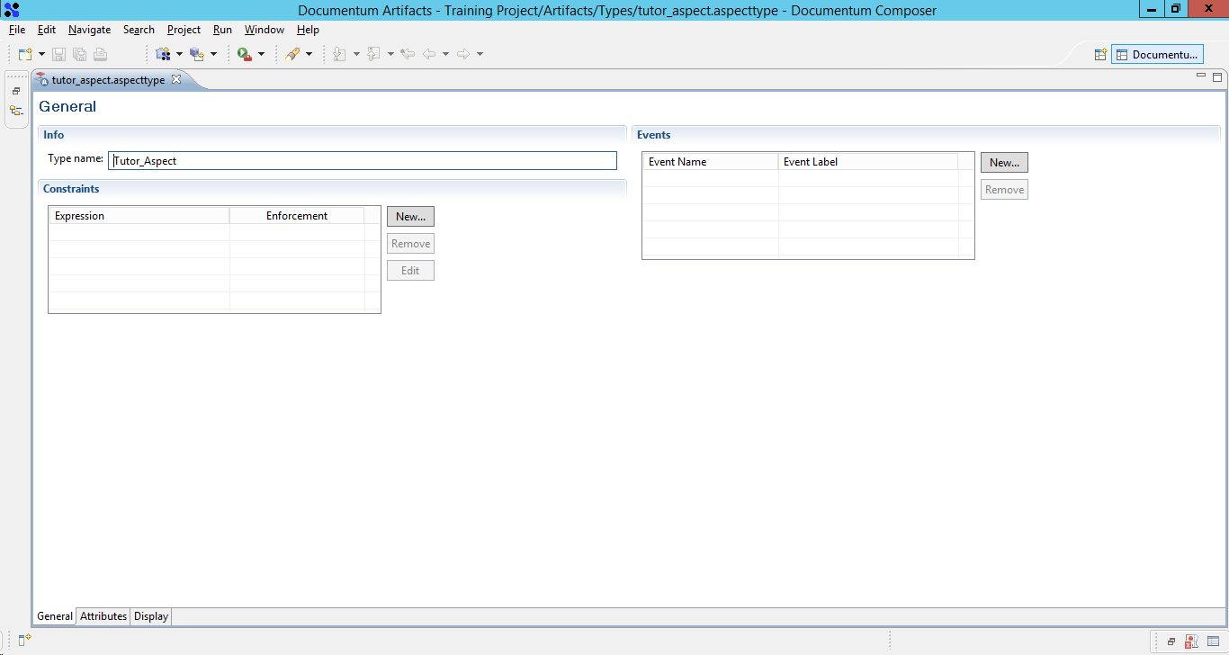
Managing Aspects and Object Types

Slide 26
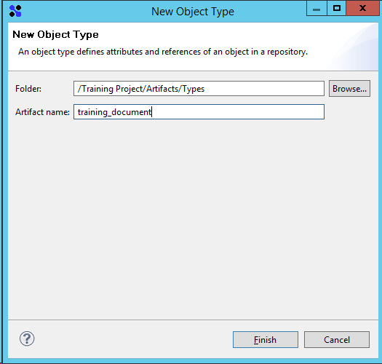
Managing Aspects and Object Types
An object type is like a template and represents a class of objects.
Creating a standard object type
Create attributes to represent real word object parameters E.g: employee_id for Employee

Slide 27
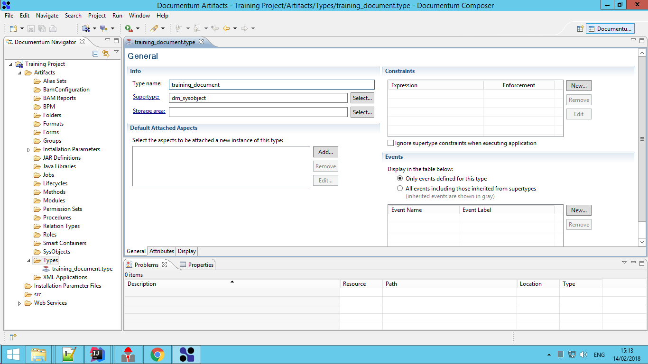
Managing Aspects and Object Types

Slide 28
Test Your Understanding
Only purpose of Object Types are to compact data for internationalization.
Yes
No
Ans: b

Slide 29
Managing Documentum Methods

Slide 30
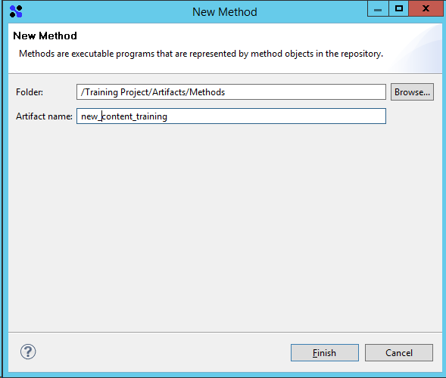
Managing Documentum Methods
Methods are executable programs represented by method objects in the repository

Slide 31
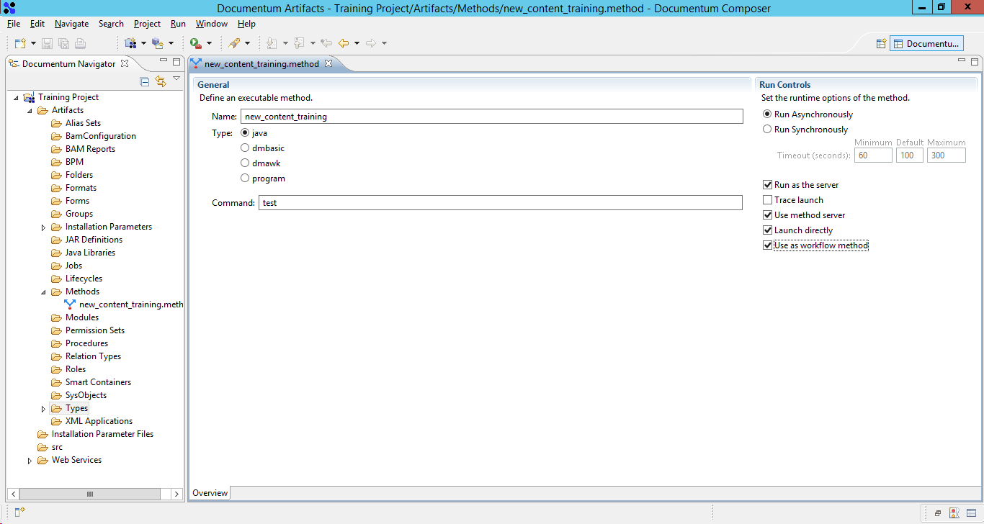
Managing Documentum Methods
The programs could use any programming language such as C++, Java etc.

Slide 32
Test Your Understanding
Documentum Methods is also a representation of an Object Type?
Yes
No
Ans: b

Slide 33
Test Your Understanding
Correct statement for Documentum Methods?
One method auto created for new object types
Useful to represent custom business logic.
Deprecated in the newer version like 7.3.
Ans: b

Slide 34
Managing Documentum Jobs

Slide 35
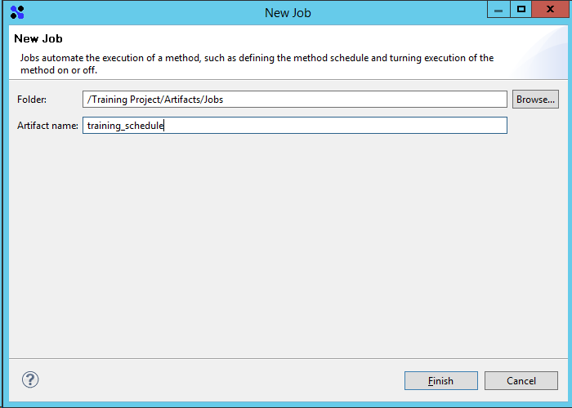
Managing Documentum Jobs
Jobs automate the execution of a method.

Slide 36
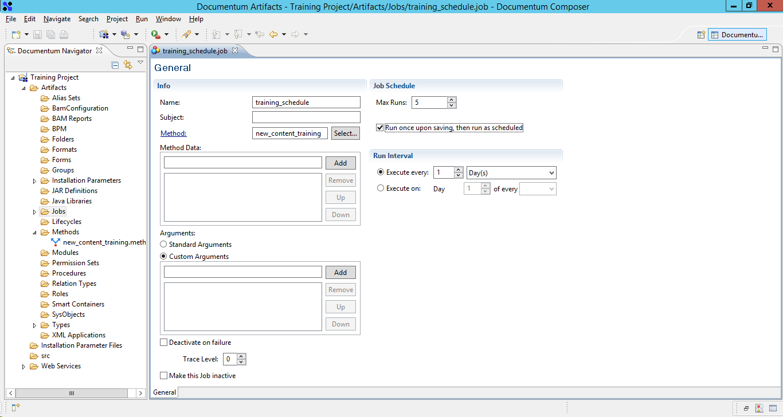
Managing Documentum Jobs
The attributes of a Job defines method’s execution schedule and could be turned on or off.

Slide 37
Test Your Understanding
Correct statement for Documentum Jobs?
One Job auto created for new Methods
Deprecated in the newer version like 7.3.
Useful for repeat execution of a Method
Ans: c

Slide 38
Managing Documentum Lifecycles

Slide 39
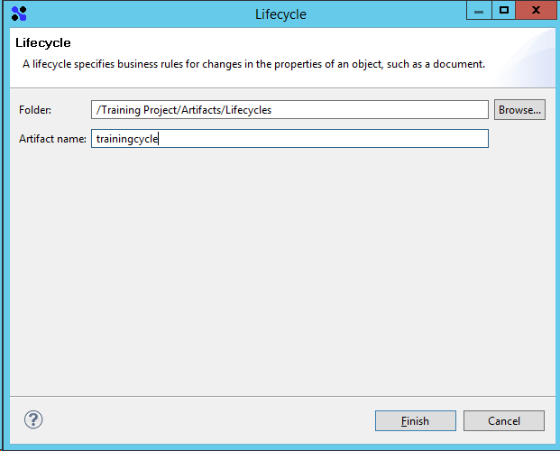
Managing Documentum Lifecycles
A lifecycle specifies business rules for changes in the properties of an object
Creating a Life Cycle

Slide 40
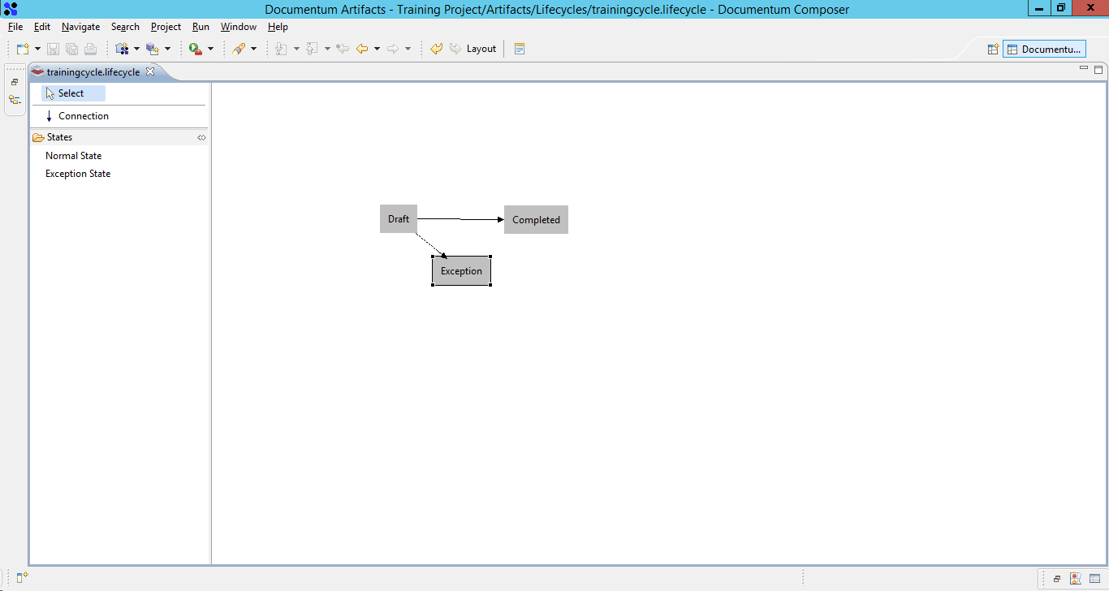
Managing Documentum Lifecycles

Slide 41
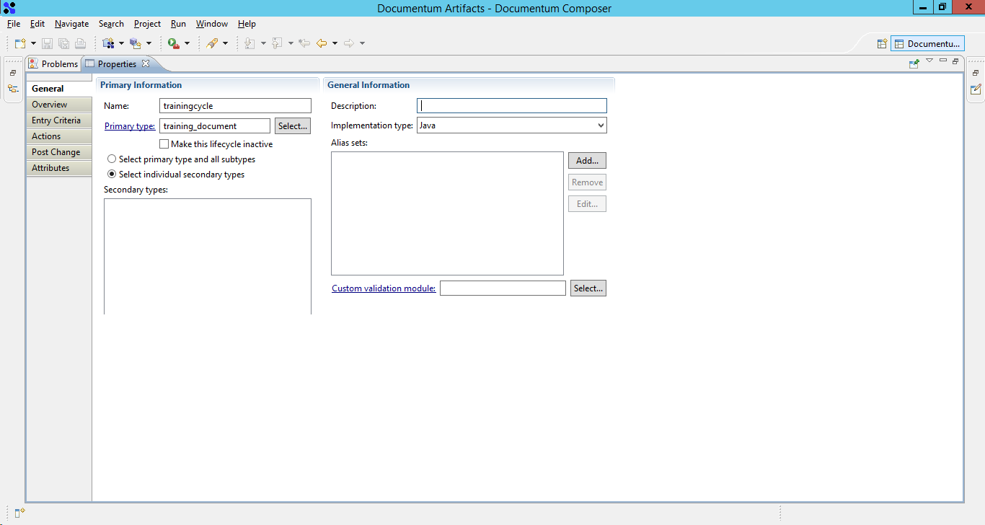
Managing Documentum Lifecycles
A lifecycle does not define what activities happen to the document while it resides in a state
Configuring lifecycle properties

Slide 42
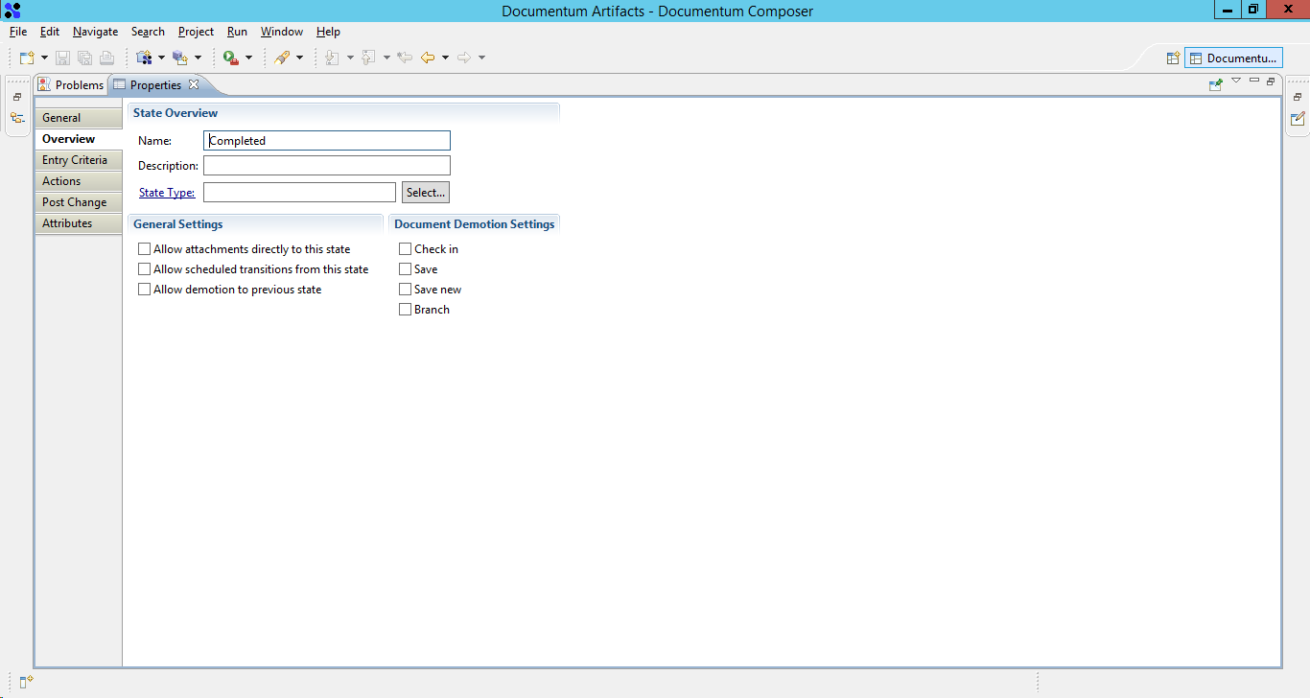
Managing Documentum Lifecycles

Slide 43
Test Your Understanding
Correct statement for Documentum Lifecycle?
Lifecycle is mandatory for each new Document in Documentum
Lifecycle is attached to a document.
Document is attached to a lifecycle
Ans: b

Slide 44
Creating Modules

Slide 45
Modules
A module consists of executable business logic and supporting material, such as third-party software.
A module is comprised of the JAR files with implementation classes and interfaces.
There are of Three Types
Modules
TBO
SBO
Aspect

Slide 46
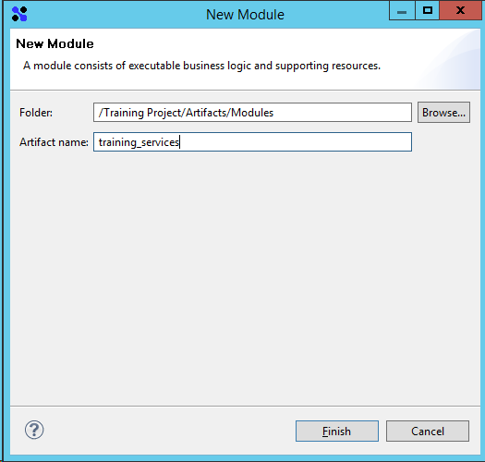
Creating Service Based Module (SBO)
An SBO provides functionality that is not specific to a particular object type or repository.
For example, an SBO can be used for user Authentication.

Slide 47
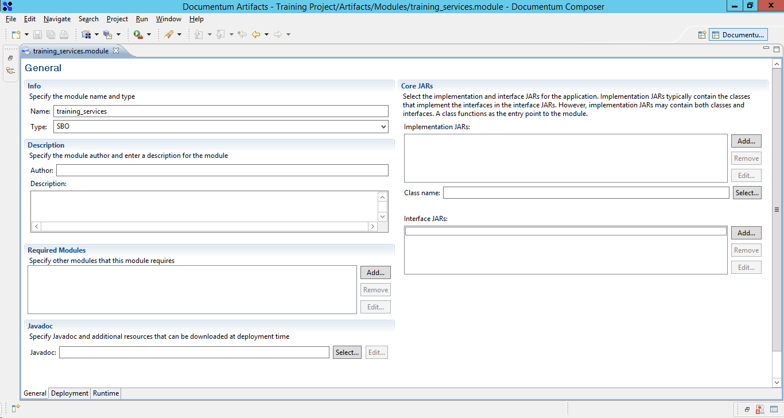
Creating Service Based Module (SBO)

Slide 48
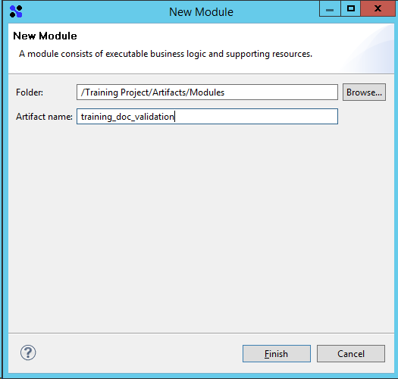
Creating Type Based Module (TBO)
A TBO provides functionality that is specific to an object type.
For example, a TBO can be used to validate the user address and location fields.

Slide 49
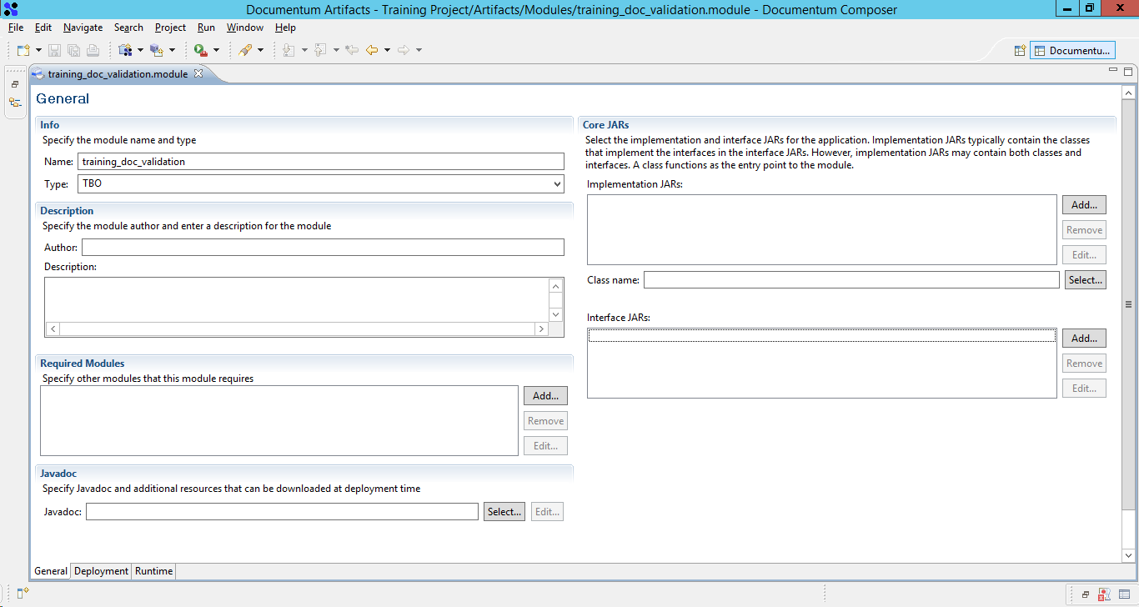
Creating Type Based Module (TBO)

Slide 50
Test Your Understanding
No of Modules Documentum allows to be created?
1
3
2
Ans: b

Slide 51
Test Your Understanding
Correct Statements about a TBO?
TBO is an independent code with no relation to object type.
TBO is deprecated from Documentum version 6.3
TBO is closely associated with the respective object type.
Ans: c

Slide 52
Test Your Understanding
Correct Statements about a SBO?
SBO is an independent code with no relation to object type.
SBO is deprecated from Documentum version 6.3
SBO is closely associated with the respective object type.
Ans: a

Slide 53
Managing Permission Sets (ACLs)

Slide 54
Managing Permission Sets (ACLs)
ACLs as Documentum Security.
All content in the repository is associated with object permissions.
ACL
Basic
Extended

Slide 55
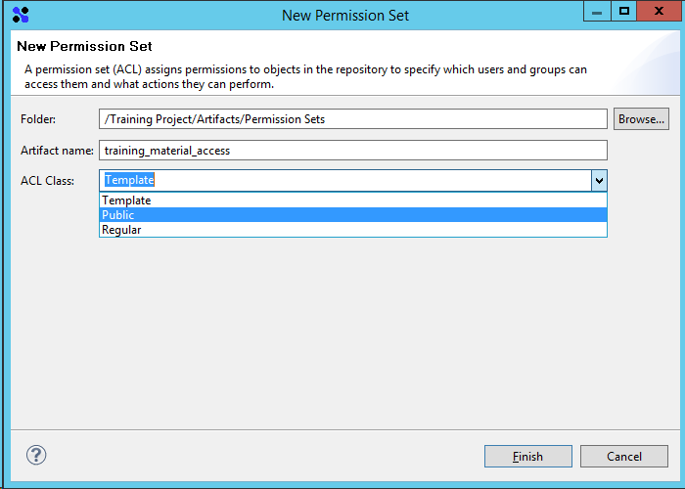
Managing Permission Sets (ACLs)

Slide 56
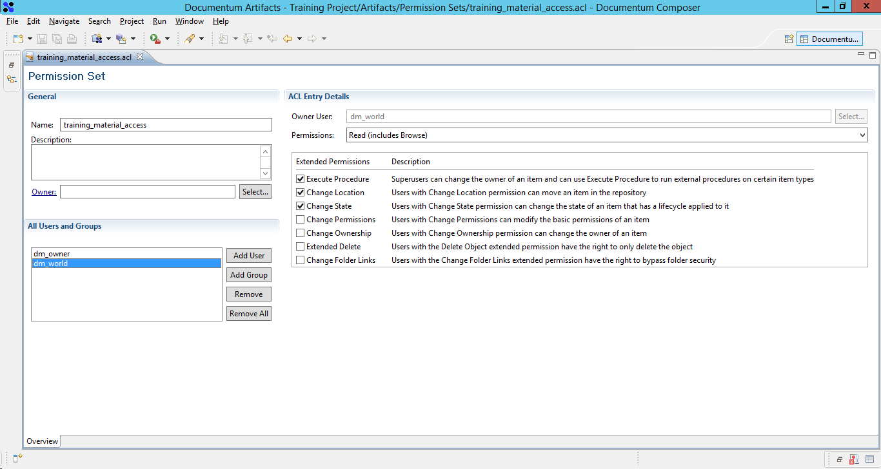
Managing Permission Sets (ACLs)

Slide 57
Test Your Understanding
Correct Statement on ACL’s applied on a document?
ACL’s are immutable objects and can never be altered
ACL’s applied on document can be altered by people with
write access on the document and no special access.
ACL’s applied on document can be changed only
with change ACL extended permission.
Ans: c

Slide 58
Managing Roles and Groups

Slide 59
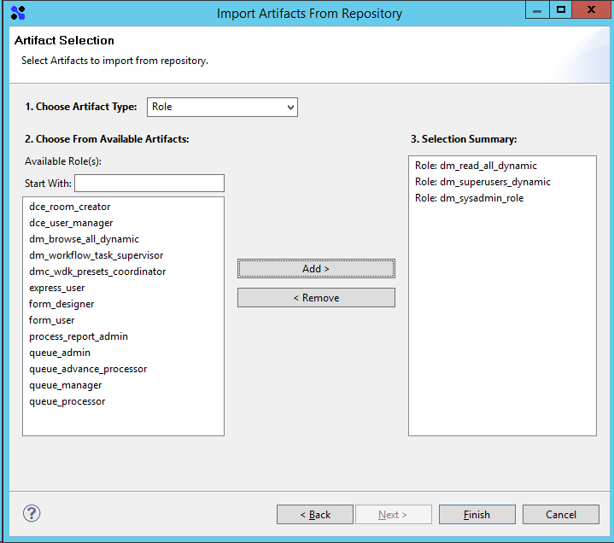
Managing Roles and Groups
Roles and Groups are created either using DQL or via Documentum administrator and imported to the composer.
Importing Roles to composer Project

Slide 60
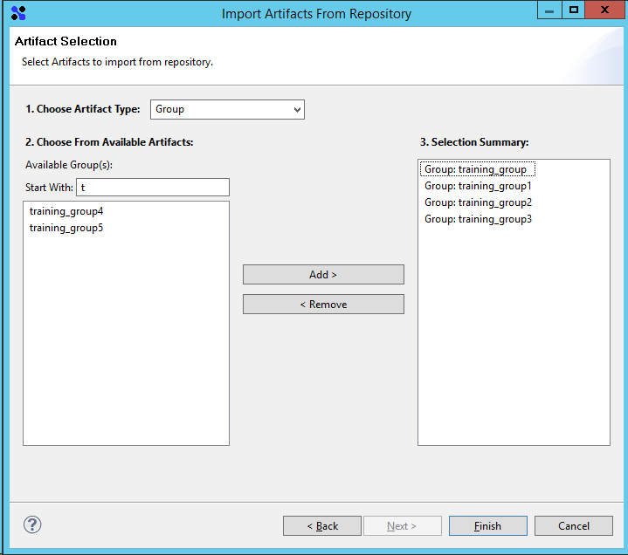
Managing Roles and Groups
Roles and Groups are created either using DQL or via Documentum administrator and imported to the Composer.
Importing Groups to composer Project

Slide 61
Test Your Understanding
Group’s & Role’s can be created using Composer?
Yes
No
Ans: b

Slide 62
Building and Installing a Project

Slide 63
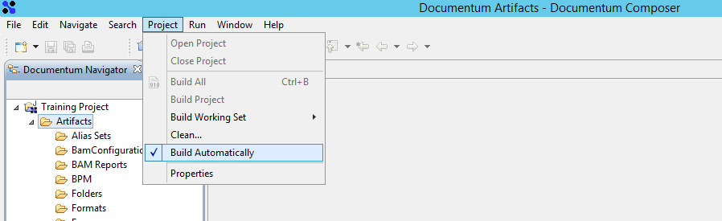
Building and Installing a Composer Project
The created Project has to be build using the composer Auto Build Functionality.
This generates the Documentum Archive (DAR) consisting of a single file that contains
the artifacts to be installed in the Documentum environment.

Slide 64
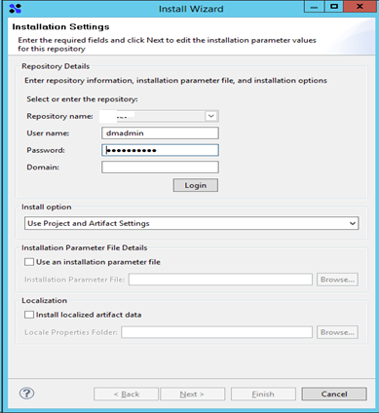
Building and Installing a Composer Project
Right click on the project to choose install Documentum project.
Providing the parameters would install the artifacts on the repository

Slide 65
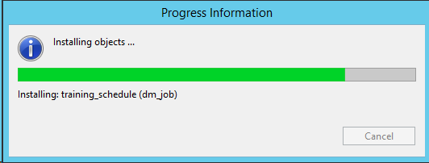
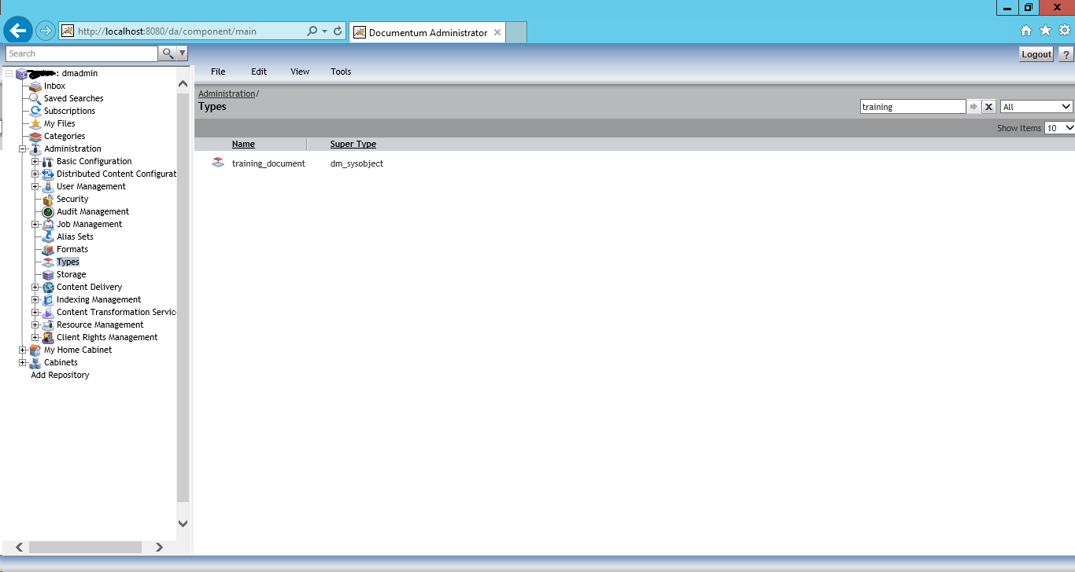
Building and Installing a Composer Project
Post Successful installation Object Types would be available in Documentum Repository an can be viewed using DA or any User Interface.

Slide 66
Test Your Understanding
Correct Statement on Documentum Installation?
Double click on the Dar and provide environment values.
Documentum artifacts created via Composer can only be
installed via Composer.
Documentum Dar file generated via Composer can
be used to install across environments.
Ans: c

Slide 67
Dar Deployment using Dar Installer

Slide 68
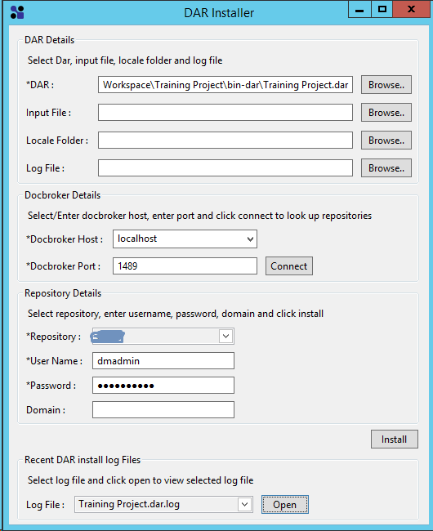
Dar Deployment using Dar Installer

Slide 69
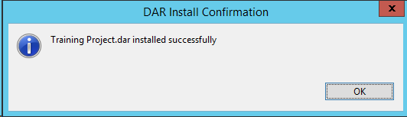
Dar Deployment using Dar Installer
DAR Installation log file could be found at “composer root path” darinstallerlogs folder
PFA: Sample Log file

Slide 70
Summary
Composer and all the major functions are explained.
Composer offers a level of flexibility and visibility in building and deployment of Documentum artifacts
Composer acts as the easy to learn environment as it is developed on eclipse and further simplifies the development of artifacts.
Please find below the Documentum artifacts and respective object type details,

Slide 71
Summary
SNO | Artifact Name | Artifact Type | Purpose
1 | Type | dm_type | Documentum Object Types
2 | Method | dm_method | Executable Programs
3 | Job | dm_job | Repeatable Execution of Methods
4 | Permission Set | dm_acl | Permissions on Documentum objects.
5 | Life Cycle | dm_policy | Life Cycle attached to documents
6 | Group | dm_group | Groups with group_class as group
7 | Role | dm_group | Roles with group_class as role
8 | Relation Type | dm_relation | Relation between objects
9 | Format | dm_format | Documentum Acceptable Formats.

Slide 72
Test Your Understanding
What is the necessary of Composer in creating Documentum applications.
Developing User Interface
Creating Documentum Artifacts
Developing XCP Applications.
Ans: b

Slide 73
Test Your Understanding
Which of the following could be created using Composer.
Business Process
Workflow’s
Functions
Lifecycle
Users
Ans: d

Slide 74
Hands-On
Create a trainee object type with below metadata, create and attach training life cycle to the trainee.
cts_trainee_type
-> Name, Age, Unit, Training PDU’s
Attachments: excel docs
(Training evaluation Report)
cts_training_lifecycle
States:
>New Entry
>Training Period
>Project Deployment

